Slide 1

Web Application Development
COMP-229

Slide 2
Web Application Development
Installing NodeJS

Slide 3
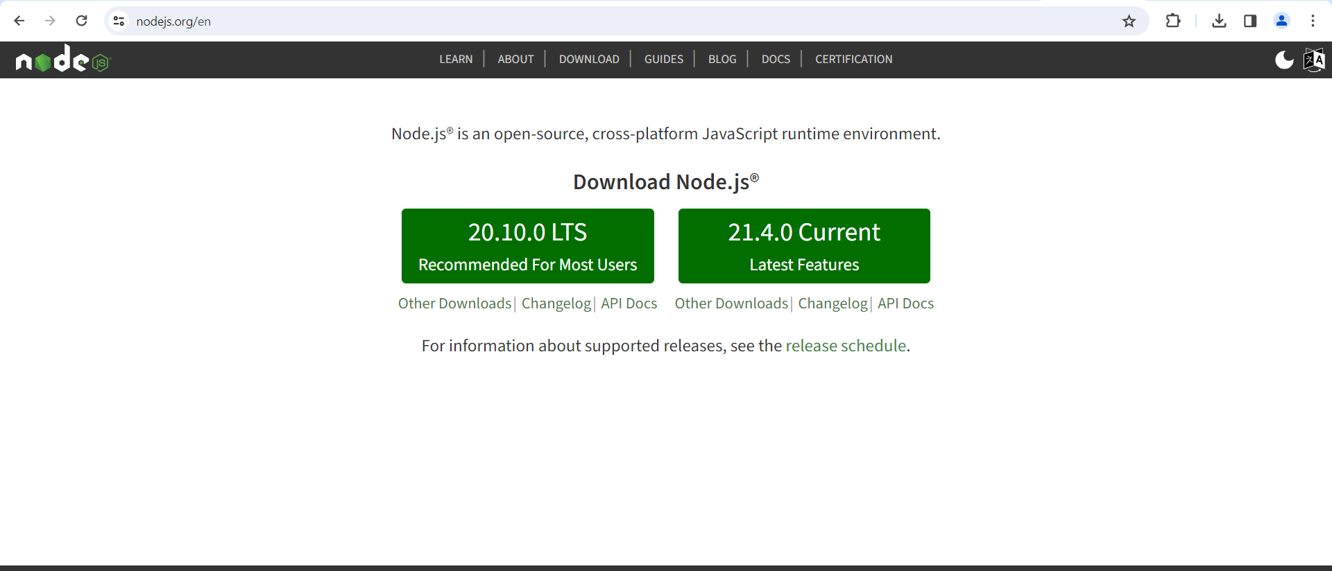
Installing NodeJS
Another core tool we’ll be using in this course is NodeJS.
Install NodeJS by navigating to https://nodejs.org and selecting the current version

Slide 4
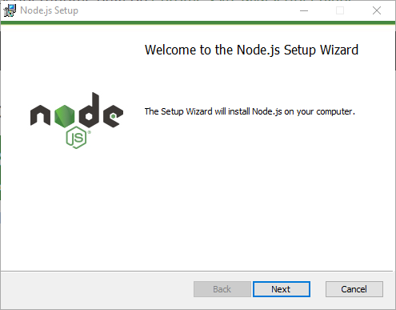
Installing NodeJS (continued)

Slide 5
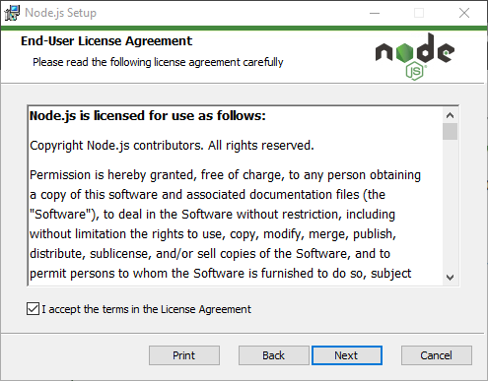
Installing NodeJS (continued)

Slide 6
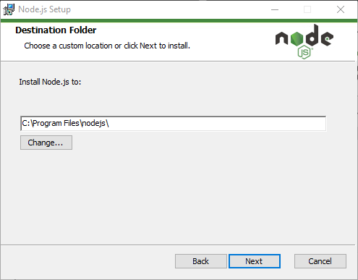
Installing NodeJS (continued)

Slide 7
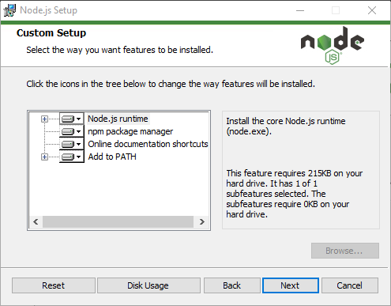
Installing NodeJS (continued)

Slide 8
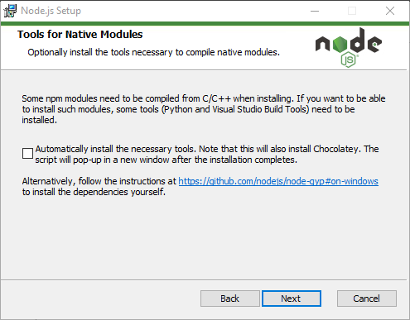

Slide 9
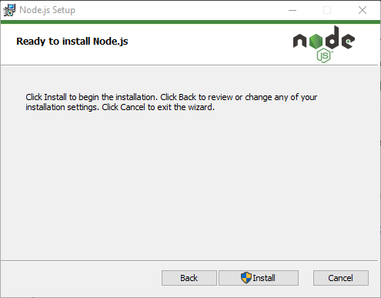

Slide 10
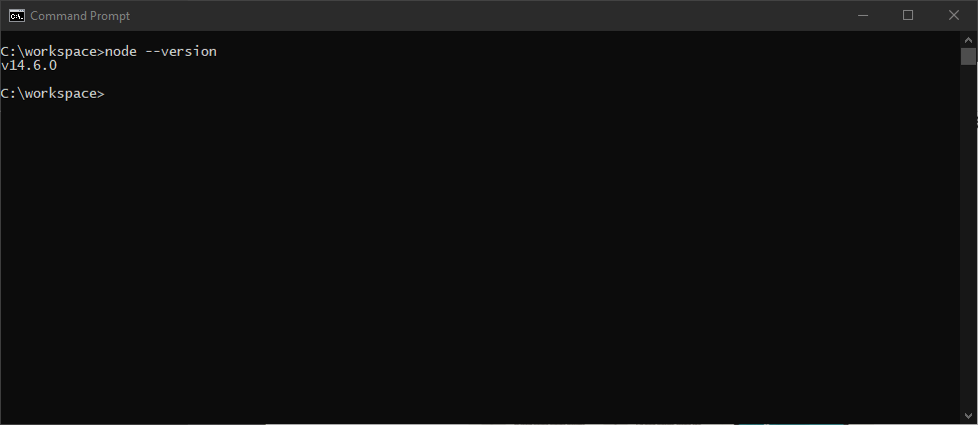
Verify your installation by opening a command prompt.
Enter the command: node --version and press enter.

